Slide 1
LG-고려대 AI Workshop 2023 Winter
Feature Engineering
Hakjun Lee
(hjlee0413@korea.ac.kr)

Slide 2
Contents
Advanced Feature Visualization
t-SNE / Animation

Slide 3
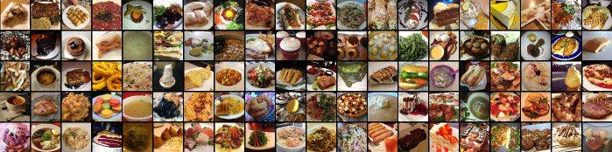
Task
Food image classification with Contrastive Learning
Dataset explanation
Food-101 – Mining Discriminative Components with Random Forests (2013)

Slide 4
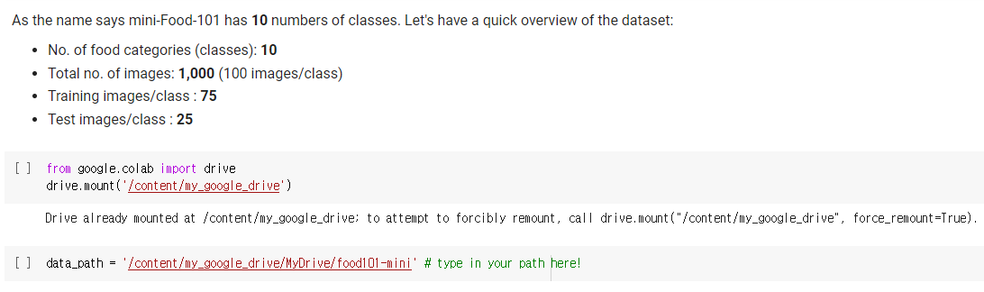
Code Section
Colab Code & Dataset Download
https://github.com/hvcl/LG_AI_workshop_2023
Dataset : feature_food101
Lab03-2_featureEngineering.ipynb
Loading Dataset

Slide 5
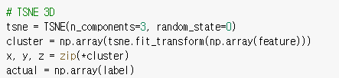
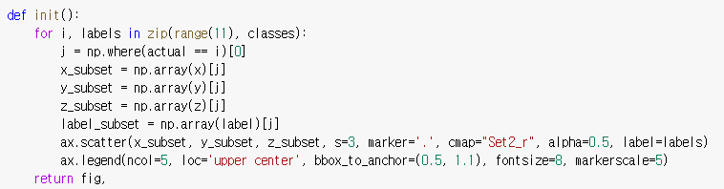
Code Section
3D TSNE

Slide 6
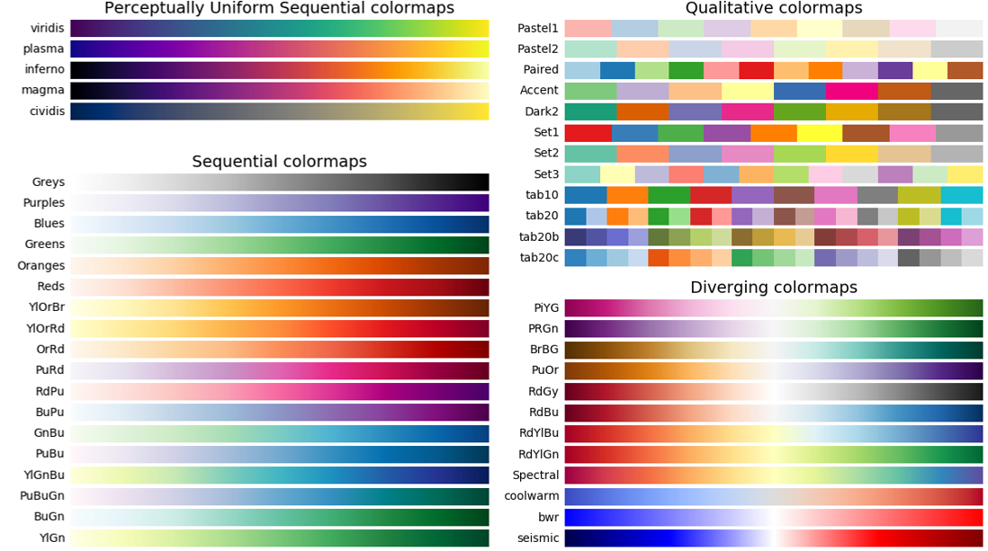
Color Map

Slide 7
개별 실습
T-SNE animation
3D tSNE animation 제작하기
Scatter 함수의 parameter를 조정해서 결과 비교하기
cmap
Marker
alpha
Legend에 숫자가 아닌 label 이름이 들어가도록 코드 완성하기

Slide 8
Thank You!

